Slide 1

Alerting Users to Fake News on Twitter
Research Proposal
A presentation submitted in partial fulfilment of the Research Methods and Professional Practice module (RMPP_PCOM7E)
MSc Computer Science
University of Essex Online
May 2022

Slide 2


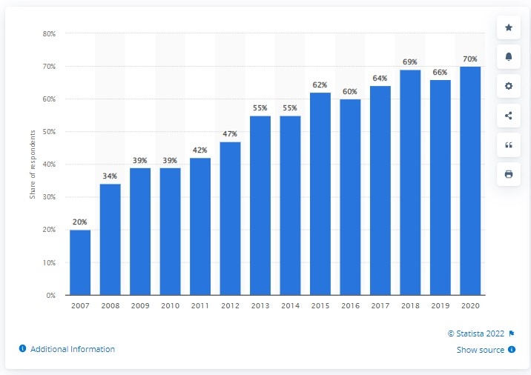
Finding News Online
2016: 38% (Bialik and Matsa, 2017)
2017: 45% (Bialik and Matsa, 2017)
2021: 68% (Shearer, 2021)
(Statistica, 2022)

Slide 3
Presentation Structure
Motivation
Research Questions
Aim
Objectives
Related Literature
Research Design
Artefacts
Timeline

Slide 4
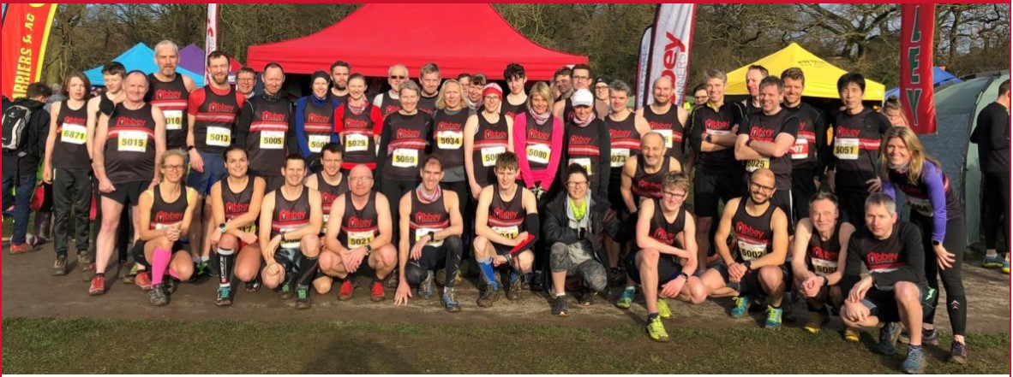

Motivation

Slide 5
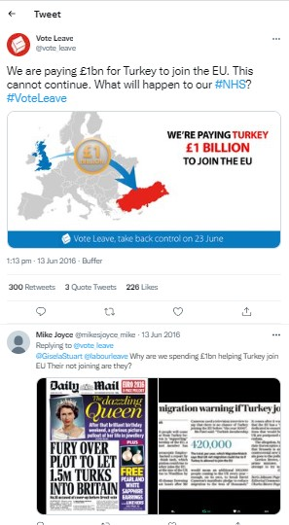
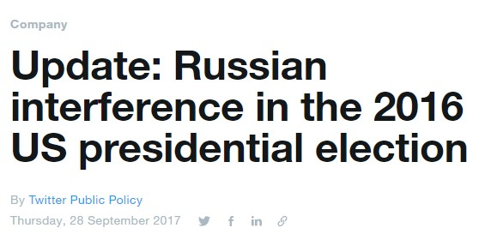
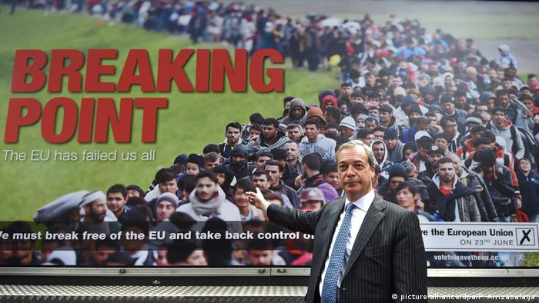
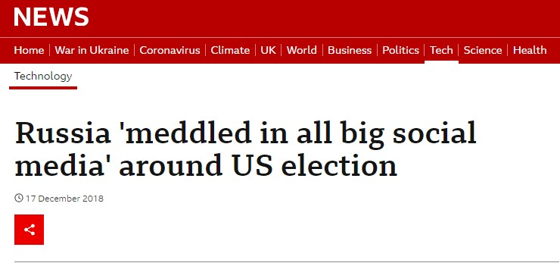
Motivation

Slide 6
Research Questions
Can Machine Learning algorithms be used to spot fake news on social media?
Can Machine Learning algorithms be used to spot fake news on social media?
How accurate is the Naive Bayes classification algorithm at identifying tweets spreading political disinformation on Twitter?
Does the accuracy increase when the algorithm utilises account details of a tweet’s source as well as the content of the tweet?

Slide 7
Aim and Objectives
Aim:
To measure the accuracy of the Naive Bayes classifier at identifying political disinformation in tweets.
Objectives:
To critically evaluate literature.
To measure the accuracy of the Naive Bayes classifier at identifying political disinformation in tweets using the content of the tweets and the account details of the source as predictors.

Slide 8
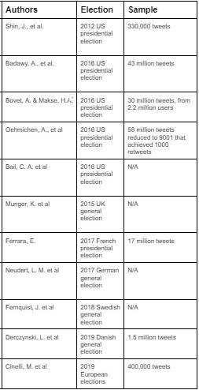
Related Literature
Misinformation on Twitter
at
Election Time

Slide 9
Related Literature
Authors | Point of Interest
Aphiwongsophon & Chongstitvatana, 2018 | Naive Bayes 97% accurate !?!
Khan et al., 2021 | Benchmarking various algorithms
Conroy et al, 2015 | Difficult to identify through content alone
Della Vedova et al., 2018 | Use tweeter’s details + tweet’s content

Slide 10
Research Methodology
Experimental Research
Naive Bayes classifier using tweet’s content
Naive Bayes classifier using both content and source
Hypothesis
> 77% accuracy when using Content and Source
Content and Source > Content only

Slide 11
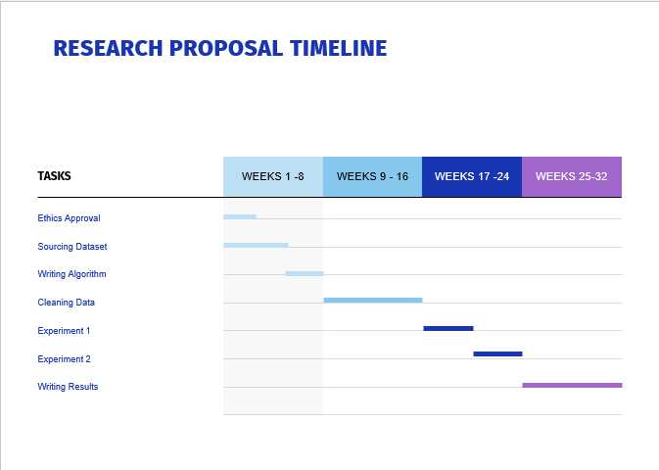
Timeline

Slide 12
References
Anon (2022) Online Newspaper and Magazine Consumption in Great Britain. Available from: https://www.statista.com/statistics/286210/online-news-newspapers-and-magazine-consumption-in-great-britain/ [Accessed 1/5/2022]
Aphiwongsophon, S. & Chongstitvatana, P. (2018) ‘Detecting Fake News with Machine Learning Method’ 2018 15th International Conference on Electrical Engineering/Electronics, Computer, Telecommunications and Information Technology (ECTI-CON), 2018, pp. 528-531, https://doi.org/10.1109/ECTICon.2018.8620051
Bovet, A. & Makse, H.A. (2019) Influence of fake news in Twitter during the 2016 US presidential election. Nat Commun 10, 7 (2019). https://doi.org/10.1038/s41467-018-07761-2

Slide 13
References
Bialik, K., & Matsa, K. (2017) Key trends in social and digital news media. Pew Research Available from:
www.pewresearch.org/fact-tank/2017/10/04/key-trends-in-social-and-digital-news-media/ [Accessed 1/5/2022]
Conroy, N.K., Rubin, V.L. and Chen, Y. (2015), Automatic deception detection: Methods for finding fake news. Proc. Assoc. Info. Sci. Tech., 52: 1-4.
https://doi.org/10.1002/pra2.2015.145052010082
Della Vedova, M.L., Tacchini, E., Moret, S., Ballarin, G., DiPierro, M. & de Alfaro, L. (2018) "Automatic Online Fake News Detection Combining Content and Social Signals," 22nd Conference of Open Innovations Association (FRUCT), 2018, pp. 272-279, https://doi.org/10.23919/FRUCT.2018.8468301

Slide 14
References
Khan, J. Y., Khondaker, M. T. I., Afroz, S., Uddin, G. & Iqbal, A. (2021) A benchmark study of machine learning models for online fake news detection. Machine Learning with Applications, Volume 4, 2021 https://doi.org/10.1016/j.mlwa.2021.100032
Oehmichen, A., Hua, K., Amador Díaz López, J., Molina-Solana, M., Gómez-Romero, J. & Guo, Y. (2019) Not All Lies Are Equal. A Study Into the Engineering of Political Misinformation in the 2016 US Presidential Election. IEEE Access, vol. 7, pp. 126305-126314, 2019, https://doi.org/10.1109/ACCESS.2019.2938389
Romm, T. and Molla, R. (2017) Junk news and Russian misinformation flooded Twitter. Available from: https://www.vox.com/2017/9/28/16378186/twitter-fake-news-misinformation-russia-oxford-swing-states [Accessed 1/5/2022]

Slide 15
References
Shearer, E. (2021) More than eight in ten Americans get news online. Pew Research Available from: https://www.pewresearch.org/fact-tank/2021/01/12/more-than-eight-in-ten-americans-get-news-from-digital-devices/ [Accessed 1/5/2022]

Slide 16
Images
Abbey Runners - personal photograph
Breaking Point (2016). Available from: https://www.dw.com/en/turkey-eu-relations-which-countries-are-for-or-against-turkish-accession/a-40381533 [Accessed 7/5/2022]
Russia meddled in all big social media around US election. Available from: https://www.bbc.co.uk/news/technology-46590890 [Accessed 3/5/2022]

Slide 17
Images
Twitter Public Policy (2017) Update: Russian Interference in 2016 Elections Available from: https://blog.twitter.com/en_us/topics/company/2017/Update-Russian-Interference-in-2016--Election-Bots-and-Misinformation [Accessed 1/5/2022]
Vote Leave 1 billion. Available from:: https://twitter.com/vote_leave/status/742328989440745472 [Accessed 7/5/2022]

